Slide 1
Chapter 3 – EXPRESS API EVENTS FUNCTIONALITY
Created By
Koustav Mukherjee

Slide 2
Content
Introduction
Create Registration.js file
Create RegistrationController.js file
Create ApprovalContraller.js file
Create RejectionController.js file
Use postman to Findout result

Slide 3
Introduction
In the previous chapter we are know about the user and event part and also known about the login for a user and now we are know about the registration for and event and also approved and event using registration_id and rejection and registration using registration_id.
We have create three controllers file that is RegistrationContraller, ApprovealController, RejectionController.
Create and registration.js file that consists registration schema.

Slide 4
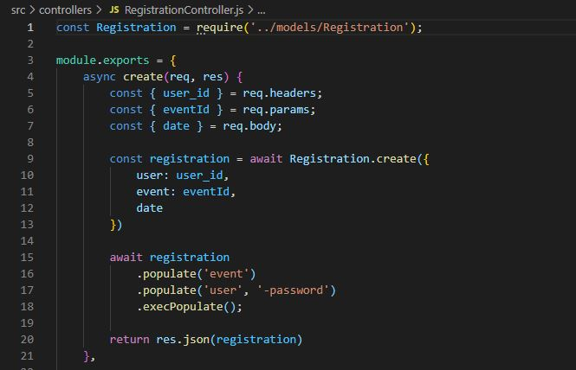
Create RegistrationController.js file

Slide 5
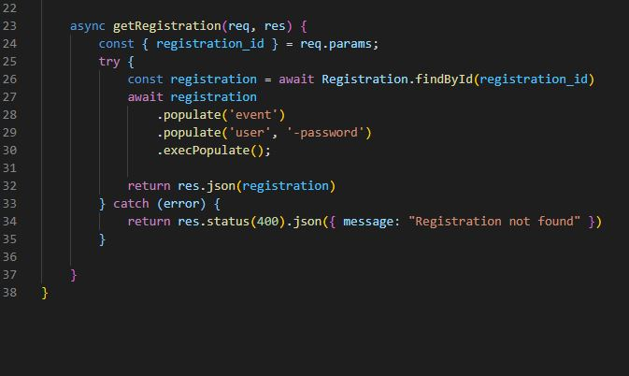
Create RegistrationController.js file

Slide 6
Explanation RegistrationController.js file
In RegistrationContraller file we use async create() method to create a registration id by using user_id or event_id, date
After creating the registration_id we use Getregistration and use FindById() method we are Findout the particular event use by populate function.

Slide 7
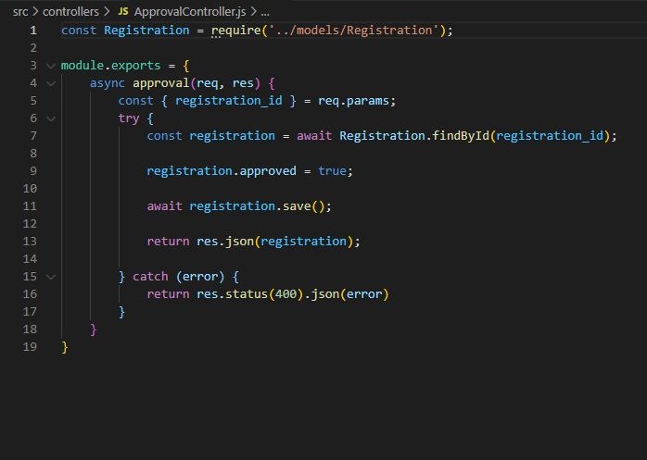
Create ApprovalContraller.js file

Slide 8
Explain ApprovalContraller.js file
ApprovalController is a controler where we are define an event approval using some Boolean function .
Use approved we Findout the registration id if the registration id is find then we match the details if the details is match then true the function .

Slide 9
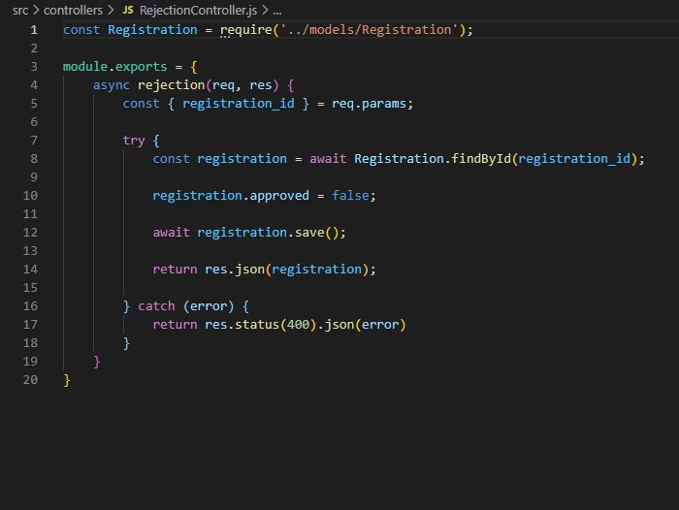
Create RejectionContraller.js file

Slide 10
Explain RejectionContraller.js file
RegisctionController is a controler where we are define an event approval using some Boolean function .
Use approved we Findout the registration id if the registration id is find then we match the details if the details is match then false the function .

Slide 11
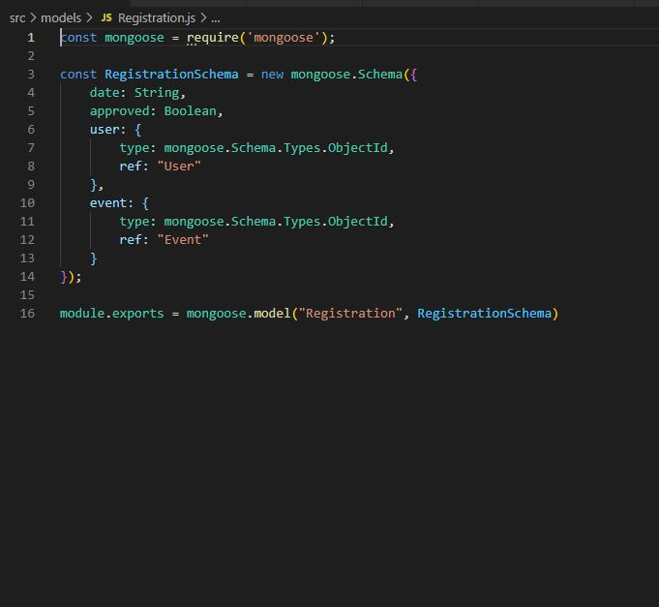
Create Registration.js file

Slide 12
Explain Registration.js file
Regitration.js is define the registration schema on the registration part .
Use the help of Boolean method we can approved and rejection and user and event.
And help of mongoose we and interact or fetch the data from database.

Slide 13
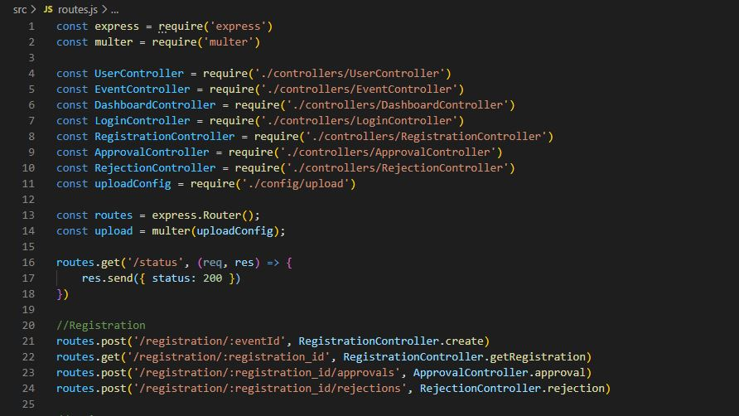
Create Routes.js file

Slide 14
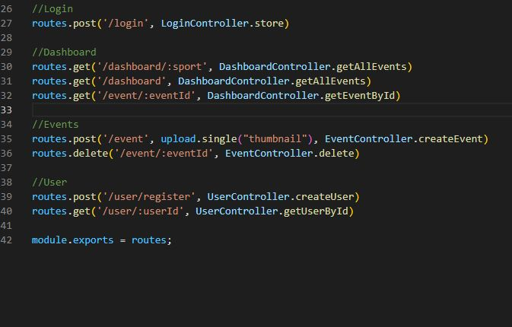
Create Routes.js file

Slide 15
Explain Routes.js file
Routes.js is a file where we are connected each file and construct the method of request .
Its connect the middleware file that’s help to server to Findout and gave the results properly.

Slide 16
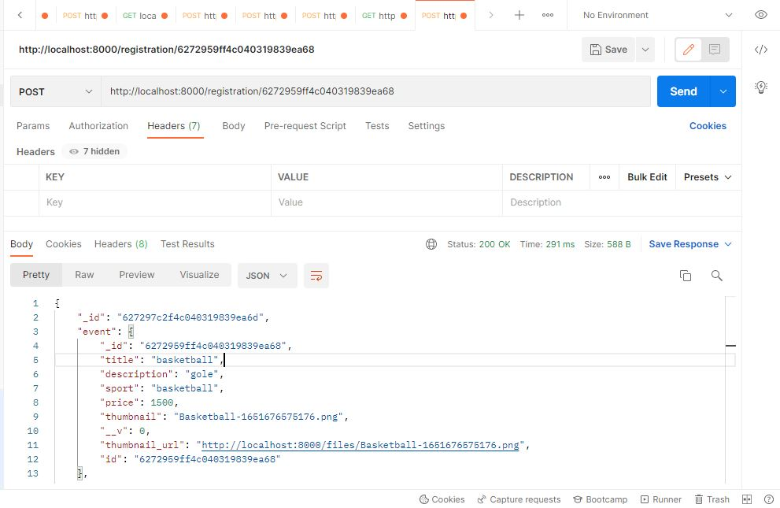
Use postman for Registration

Slide 17
Use postman for Registration
Step 1 – For new request go to “+” icon and add a new request .
Step 2 – Select method post and put localhost:8000/registration/event_id
Step 3 – Select herder click on send and result is given bellow. if we gave the registration id then its show the result.

Slide 18
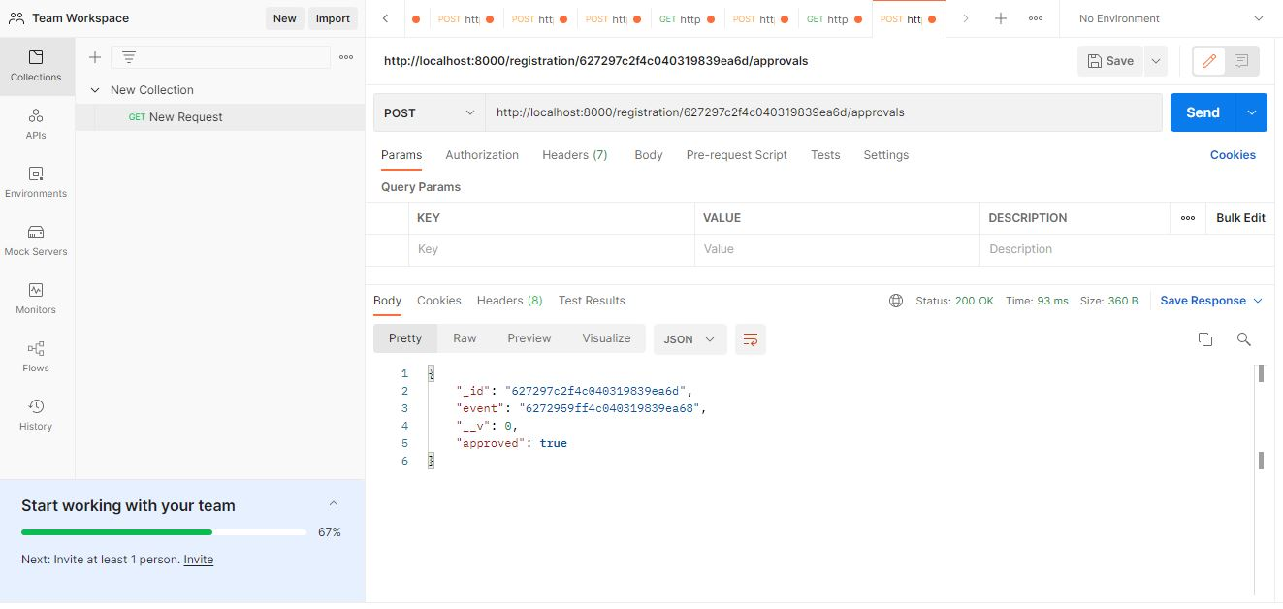
Use postman for approval

Slide 19
Use postman for approval
Step 1 – For new request go to “+” icon and add a new request .
Step 2 – Select method post and put localhost:8000/registration/registration_id/approvals
Step 3 – send the request its gives the result against the registration id is true that’s mean that particular registration id is approved.

Slide 20
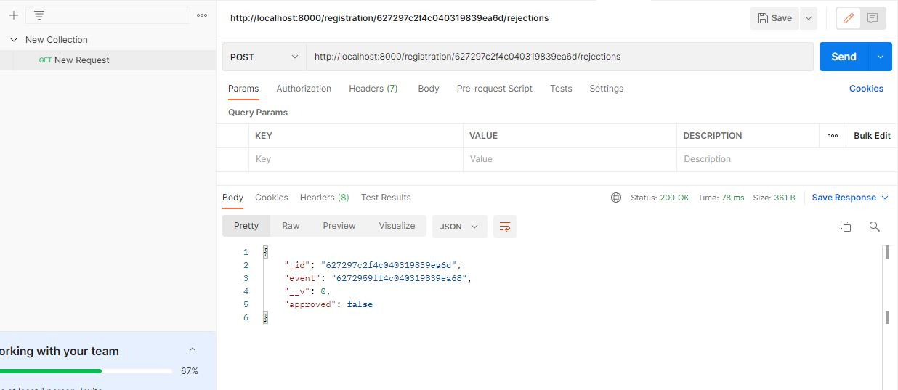
Use postman for Rejection

Slide 21
Use postman for Rejection
Step 1 – For new request go to “+” icon and add a new request .
Step 2 – Select method post and put localhost:8000/registration/registration_id/rejections.
Step 3 – send the request its gives the result against the registration id is false that’s mean that particular registration id is rejection is done.

Slide 22
THANK YOU

